Slide 1


Analyzing
Social Buzz Data

Slide 2


Today's agenda
Project recap
Problem
The Analytics team
Process
Insights
Summary

Slide 3

Social Buzz is a social media and content creation company established in San Francisco in 2018. It emphasizes content by keeping all users anonymous and only tracking user reactions to every piece of content. Over the past 5 years, Social Buzz has reached over 500 million active users each month.
Due to their rapid growth and the digital nature of their core product, the amount of data that they create, collect, and must analyze is huge. Every day, over 100,000 pieces of content, ranging from text, images, videos, and GIFs, are posted. But to maintain and manage this huge data, they need cutting edge technology. That is why Social Buzz relies on Accenture.
However, there are three main reasons why they are now looking to bring in external expertise:
1. They are looking to complete an IPO by the end of next year and need guidance to ensure that this goes smoothly.
2. They want an experienced team to maintain and manage their growing data.
3. They want to learn data-management best practices from a large corporation. And they want to know how large organizations manage the challenges of big data.
Project Recap

Slide 4


Problem
Analyzing the Social Buzz data and uncover the top five (5) categories with the largest aggregate popularity.

Slide 5



Chief Technology Architect - Andrew Fleming
Senior Principal - Marcus Rampton
Data Scientist - Michelle Grove
Data Analyst - Ayyappanaidu Kunche

Slide 6
Data Cleaning: Deleting rows with missing (null) values from the Content, Reaction, and Reaction Type tables.
Process
1
Column Identification: Selecting the required columns for this problem.
2
Merging: Joining the selected columns from the Content, Reaction, and Reaction Type tables.
3
Aggregate Operation: Performing cluster operations on the Categories Reaction Score columns and Identifying the top five categories in terms of their highest reaction scores.
4
5
Reporting: Visualizing Categories and the total reaction score using a histogram.

Slide 7

Insights
About the data: In the process of solving the Social Buzz business problem, we were given three datasets named Content, Reaction, and Reaction Type.
Content Dataset: It consists of five columns: ID, User ID, Type, Category, and URL. It gives information about the content on the platform, such as the content's unique ID, Type, User ID, Category of the content and the Address where it is being stored.
Reaction Dataset: It consists of four unique columns: Content ID, User ID, Type, and Datetime. This dataset provides information about the reactions to the content, such as the unique ID of the created content, the User ID of the user who reacted to the content, the type of user reaction, and the date and time of the user's reaction to the content on the platform.
Reaction Type Dataset: It consists of three unique columns: Type, Sentiment, and Score. This dataset shows information about the score of the type of reaction that the user gave the content, such as type of the reaction the user gave, sentiment of the user reaction and score of the reaction.

Slide 8
Insights
16
UNIQUE CATEGORIES
CATEGORY ‘’ANIMAL’’ HAVING HIGHEST REACTION SCORE
‘’JANUARY’’ HAS HIGHEST MONTHLY POSTS

Slide 9
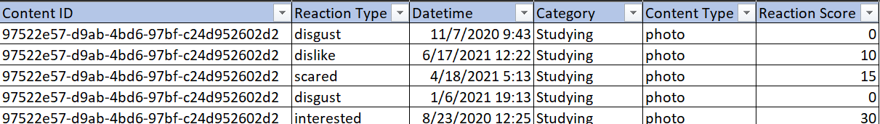
Cleaned Dataset:
As per the problem statement, we have cleaned three datasets: content, reaction, and reaction type, by deleting rows with empty values and unnecessary columns. After that, we joined three data sources and formed a cleaned dataset. In the above snippet, we can see the columns and first five rows of the dataset.

Slide 10
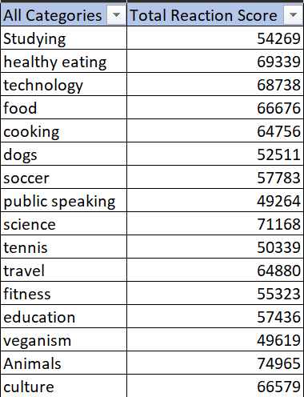
Aggregate Reaction Score:
After cleaning the dataset, we have created two new columns, All Categories and Total Reaction Score, to perform aggregate operations. In the snippet, we can see that we have 16 different categories and their corresponding total reaction scores.

Slide 11
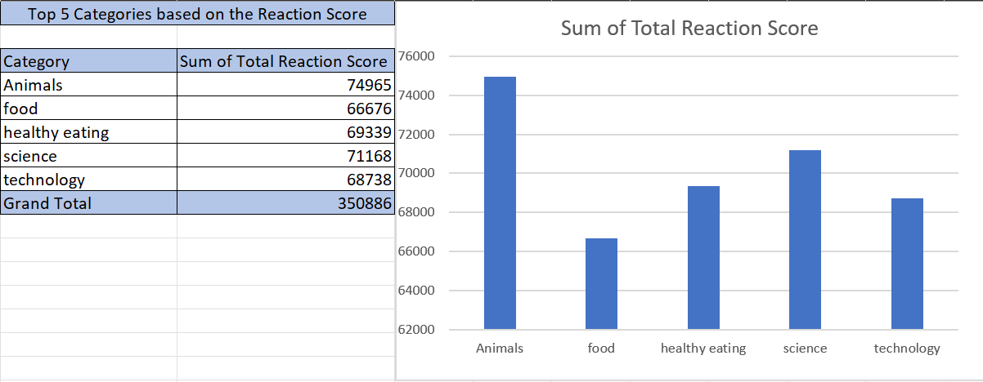

Slide 12
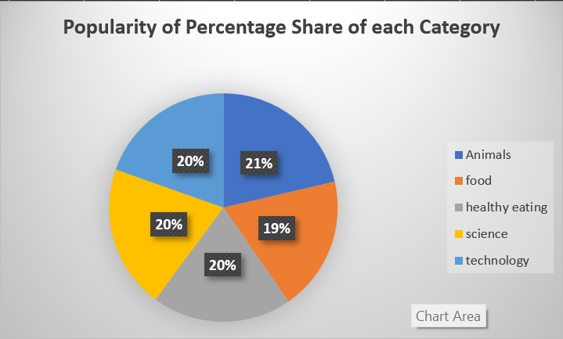
Animals' content has the highest percentage share of 21% when compared to the other four top categories.

Slide 13

Animals, food, healthy eating, science, and technology are the top five categories that contribute the most traffic to the business. We believe that the organization should focus more on these five top categories, recommend them to more users, and also include advertisements in the same category, resulting in a stable user base and an increase in significant revenue for the company.
Summary

Slide 14

Thank you!
ANY QUESTIONS?

